Slide 1
Why He Was Promoted
Author Unknown

Slide 2
Stanza 1

Slide 3
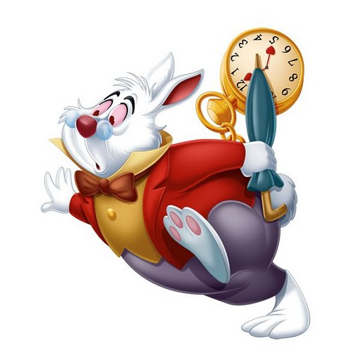
He was always on time.

Slide 4
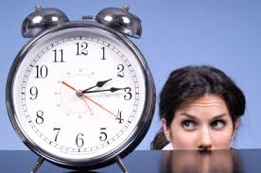
He did not watch the clock.

Slide 5
He put his heart in his work.

Slide 6
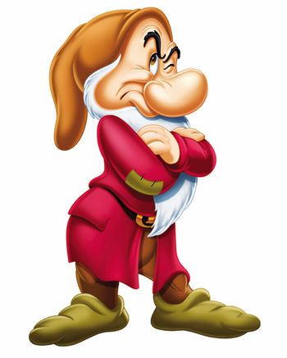
He was not always grumbling.

Slide 7
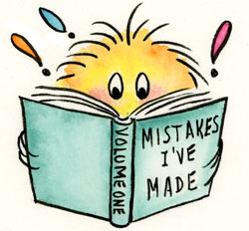
He learned from his blunders.

Slide 8
Review Stanza 1

Slide 9
Stanza 2

Slide 10
He acted on his own judgment.

Slide 11
He was ready for the next step.

Slide 12
He did not ask too many questions.

Slide 13
He thought is was worth while to learn how.

Slide 14
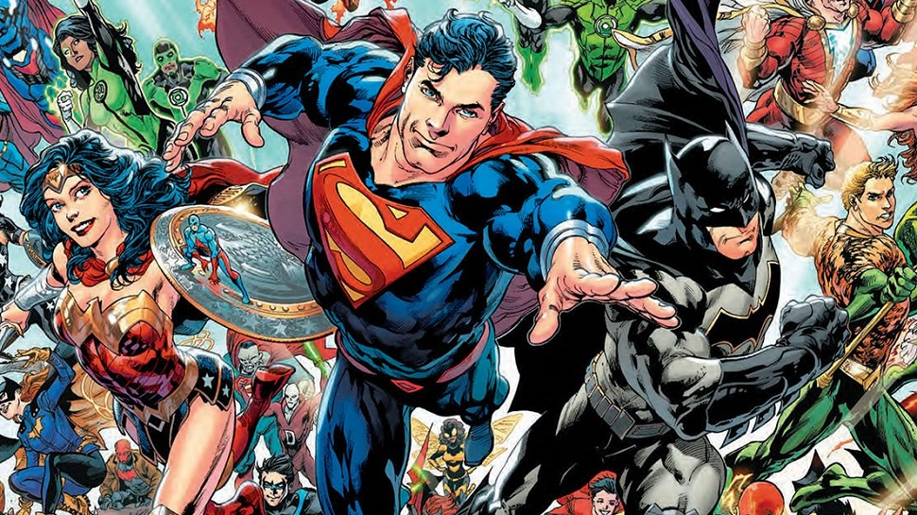
He chose his friends among his superiors.

Slide 15
Review Stanza 2

Slide 16
Review Stanza 1

Slide 17
Review Stanza 2

Slide 18
Stanza 3

Slide 19
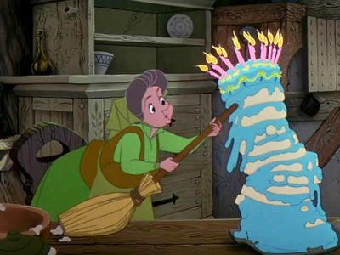
He did not ruin his ability by half doing things.

Slide 20
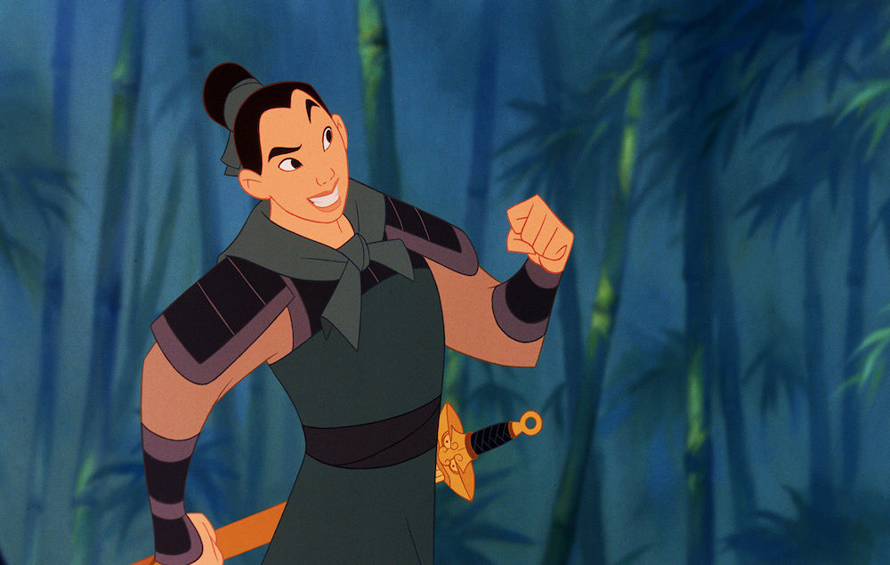
He imitated the habits of men who could accomplish more than he could.

Slide 21
He learned that the best part of his salary was not in his envelope.

Slide 22
Review Stanza 3

Slide 23
Review Stanza 1

Slide 24
Review Stanza 2

Slide 25
Review Stanza 3

Slide 26
